Slide 1
Welcome

Slide 2
A Seminar on Weather forecasting using data science Domain : Data science guide : prof. n.v.Gawali name : Ankit Pawar class : Te Roll no : 106

Slide 3
Seminar & Technical Communication
Topic : Water Monitoring System in IOT

Slide 4
Contents :
1) Introduction
2)Motivation
3) Literature Review
4) Principle
5) Architecture
6) Components
7) Applications
8) Advantages
9) Disadvantages
10) Conclusion
11) Reference

Slide 5
Introduction :
Currently drinking water is very prized for all the humans. In recent times water levels are very low and water in the lakes are going down. So its too important to find the solution for water monitoring & control system. IoT is a solution. In recent days, development in computing and electronics technologies have triggered Internet of Things technology. Internet of Things can be describe as the network of electronics devices communicating among them by the help of a controller. The IoT is a collection of devices that work together in order to serve human tasks in a efficient manner. It combine computational power to send data about the environments. These devices can be in form of sensors, appliances, embedded systems, and data analysis microchips. This paper present a low cost water monitoring system, which is a solution for the water wastage and water quality.

Slide 6
Motivation :
Water Pollution and water scarcity is a global problem, which requires ongoing modification of water resource guiding principle at the levels of international down to individual wells. It has been surveyed that water pollution isthe leading cause of diseases worldwide. The records show that more than 10000 people die daily worldwide. In India predictable 500+ people die of water pollution related problems every day. Research has shown that after few years the quantity of useful water will be goes down to minimum level. In many developing countries, dirty or contaminated water is being used for drinking without any proper former using it. One of the reasons for this happening is the unawareness of public and administration and the lack of water quality monitoring system which creates serious global issues. Also natural effects such as volcanoes, algae tints, and earthquakes also change the quality and ecological status of water.

Slide 7
Literature Survey
Author(s) | Title of Paper/Study | Key Findings
Lambrou et al. (2014) | "Development of reliable water control system" | - The RF transceivers used for wireless communication to the internet server. With the help of a microcontroller, the system is fully programmed of the user unless the water the bottle is drained or overflowed. The sensor array is used to measure various parameters such as dissolved Oxygen, Tumble, pH, Temperature, etc. Sensor array. Costs of installation are reduced because of the wireless system.
Prasad et al. (2015) | " smart Water Quality Monitoring (WQM) device for Fiji " | - The Pacific Islands of Fiji require regular collection and analysis of collected data for the water quality monitoring and uploading this data into the server. In order to monitor water quality, the authors have used IoT and remote sensing technologies.
Omar Faruq et al. (2017) | " water quality monitoring system based on microcontrollers " | - A water quality monitoring system based on microcontrollers for people living in Bangladesh's outskirts, where safe drinking water is not available, is provided in this paper.

Slide 8
PRINCIPLE :
The main principle of this circuit is that the device placed at any particular place can measure the quality of water based on pH scale and the temperature of water and soil moisture.

Slide 9
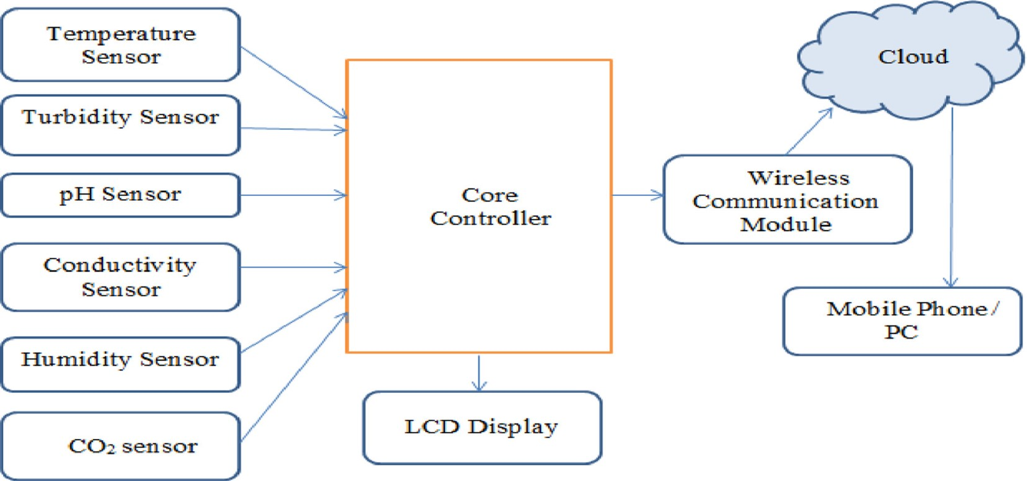
Architecture of WMS

Slide 10
Top five hardware components of a Smart Water Quality Monitoring system :
Ultrasonic sensor
As the name suggests, the sensor generates a high-frequency sound wave of 40 kHz to send and receive ultrasonic pulses that relay back information about an object's proximity. This hardware provides a 2 cm to 4 cm measurement range

Slide 11
pH sensor :
The sensor measures the amount of alkalinity and acidity in water and other metrics. When used correctly, the smart solutions can measure the safety and quality of the product and the processes occurring at a wastewater or manufacturing plant.

Slide 12
Digital thermometer sensor
It is commonly used to measure the temperature and humidity values of the surrounding atmosphere. It comes with an 8-bit microscope and a Negative Temperature Coefficient (NTC) tool for measurements.

Slide 13
Turbidity sensor
The sensor helps calculate the quality of clear water, i.e., the number of particles in water. It utilizes light to identify whether the water is opaque or murky by transmitting light beams. Excess turbidity can reduce marine life and reproduction and cause various forms of human illness. The sensor generates both analog and digital mode output.

Slide 14
RF module
Short for radio-frequency, the module is a small electronic device that transmits and/or receives radio signals between two devices. An embedded IoT-based cost-effective and efficient system comes in handy to initiate communication between two smart sensors.

Slide 15
APPLICATIONS :
• Agriculture fields
• Water purifiers at low cost
• Industries
• Home
• Hotels
• Airports

Slide 16
ADVANTAGES :
Mostly used soil moisture sensor in agriculture fields so nutrients will be safe.
By the pH value, it can able to know drinkable, usable, etc.,
In industries mostly used temperature and pH sensors whether it is under temperature and quality water used in instant products
More sensors and personal applications we can emerge….

Slide 17
DISADVANTAGES :
Day by day the device using the pH electrode may get damaged and it may not worked further….
More programming should be done, it should be connected to internet daily…
If it is placed in agriculture fields openly the device get damaged by weather, disturbing animals etc.,

Slide 18
CONCLUSION
In this paper, a prototype water monitoring system using IoT is presented. .For this some sensors are used. The collected data from the all the sensors are used for analysis purpose for better solution of water problems. The data is sends to the cloud server via Wi-Fi module ESP8266. So this application will be the best challenger in real time monitoring & control system and use to solve all the water related problems.

Slide 19
References
Water Monitoring in IOT - Vijay Kumar Didal( September 2017)
https://www.investopedia.com/
https://www.dataversity.net/
www.wikipedia.com

Slide 20
Thank you ☺

